Slide 1
4.1 Reproduction & Cell Division

Slide 2
ASEXUAL Reproduction

Slide 3
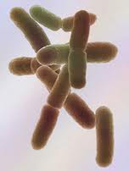
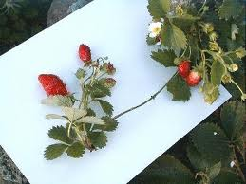
What is it?
One parent producing an offspring identical to itself.
No genetic variation

Slide 4
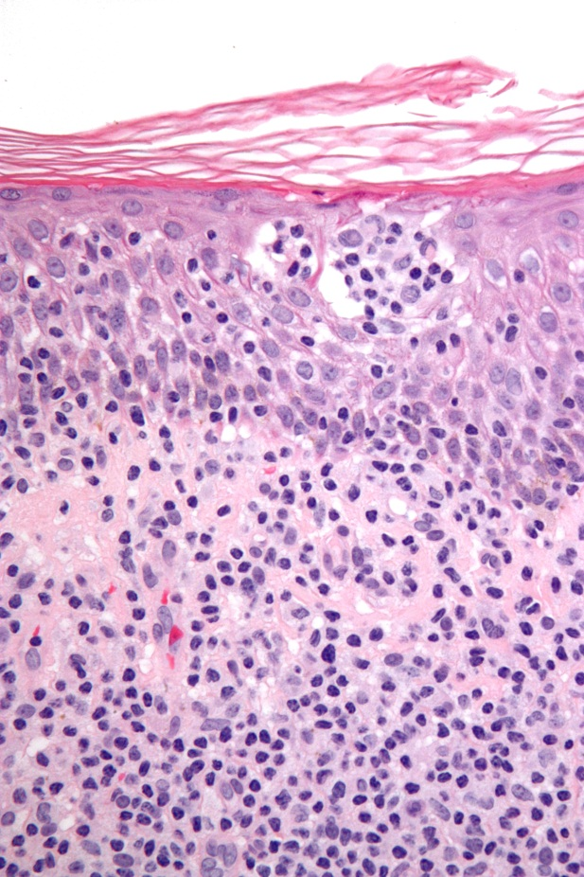
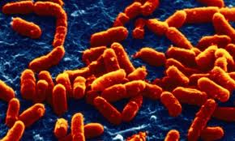
What types of organisms undergo asexual reproduction?
Unicellular organisms (bacteria)
Somatic cells (body cells) of multicellular organisms
(ALL Non-Sex Cells!)

Slide 5
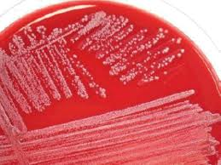
Advantages
Quick, Simple, Offspring are identical to the parent (Ex. Skin cells produce skin cells!)

Slide 6
Disadvantages
Asexual reproduction creates EXACT copies
NO DIVERSITY! What can harm one organism, can harm all!

Slide 7
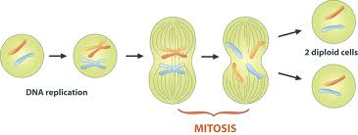
Mitosis

Slide 8
Cell Division: Mitosis
PROCESS: Asexual cell division
PURPOSE: Create two genetically identical cells
CELLS TYPES:
Body Cells / Somatic Cells
(ALL Non-Sex Cells)

Slide 9
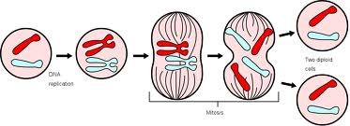
Cell Division: Mitosis
# OF PARENT CELLS: One
# of DIVISIONS: One
# OF DAUGHTER CELLS (Offspring): Two
GENETIC MATERIAL:
Offspring DNA is Identical to parent

Slide 10
VOCABULARY
DIPLOID = Full (2n) set of chromosomes
1 set from mom (23)
1 set from dad (23)
2 sets = 2n (46)
Mitosis starts with 1 DIPLOID cell and ends with 2 DIPLOID cells

Slide 11
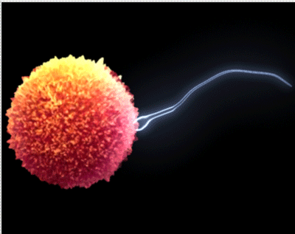
Sexual Reproduction & Meiosis

Slide 12
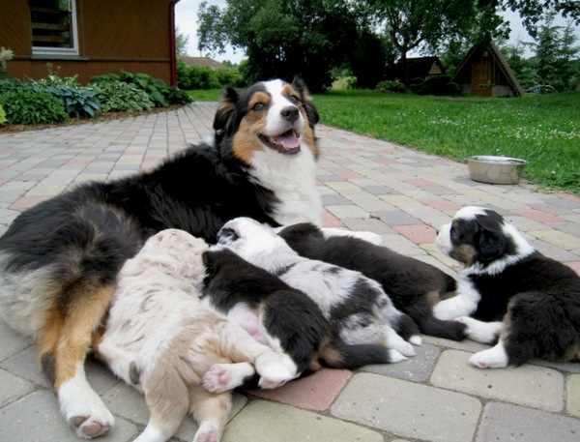
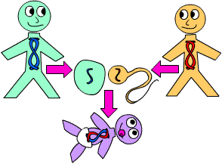
What is it?
Creating a new organism by combining the genetic material of two organisms.
Offspring are genetically
unique from their parents

Slide 13
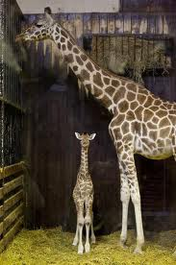
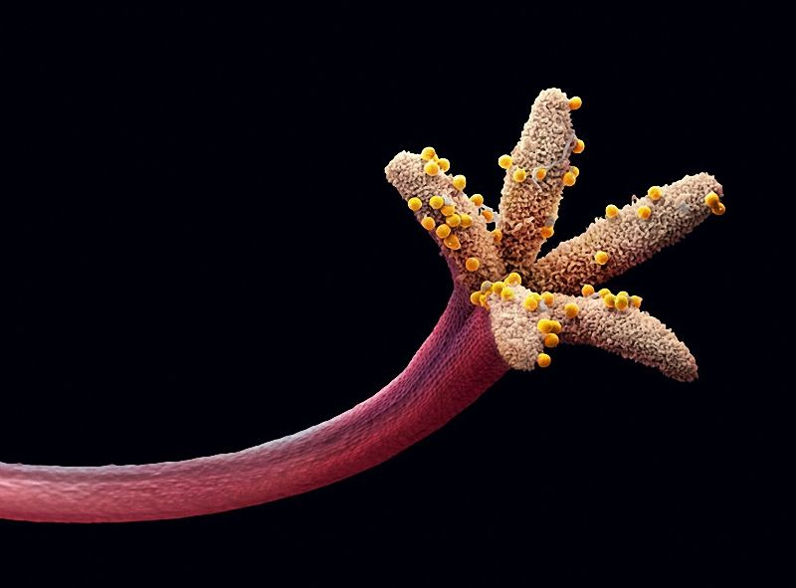
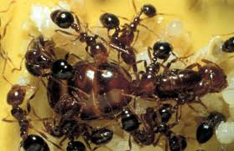
What types of organisms undergo sexual reproduction?
Multi-cellular organisms:
Plants & Animals

Slide 14
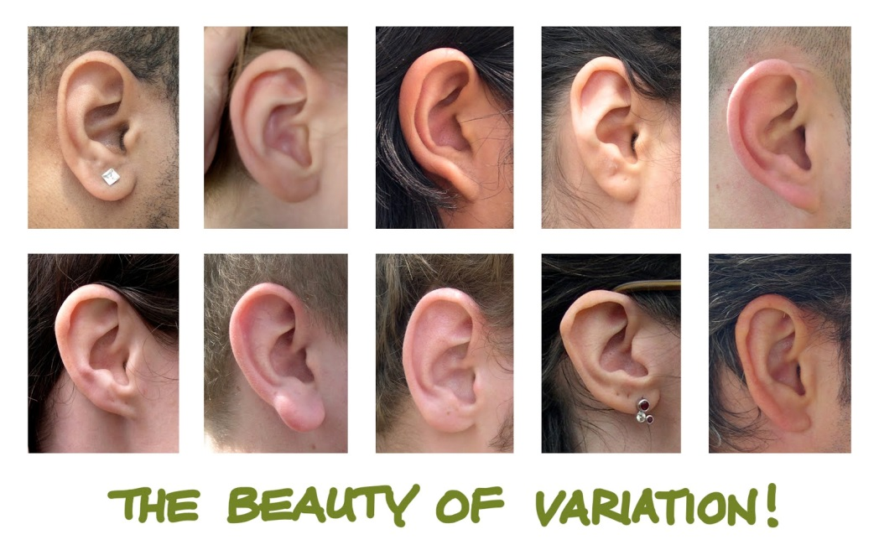
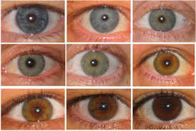
Sexual Reproduction
Purpose
Create genetically diverse offspring.

Slide 15
Advantages
A diverse population can better adapt to changes in the environment & avoid extinction

Slide 16
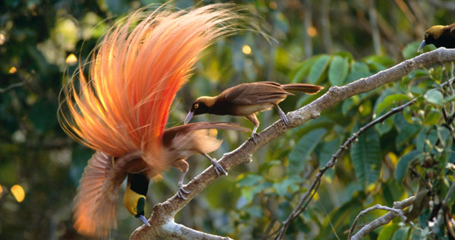
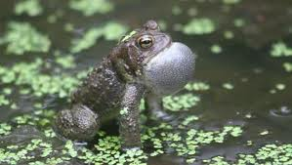
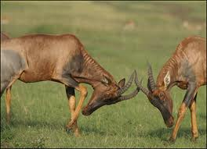
Sexual Reproduction
DISADVANTAGES
-Takes longer to produce offspring
-Need to find a mate

Slide 17
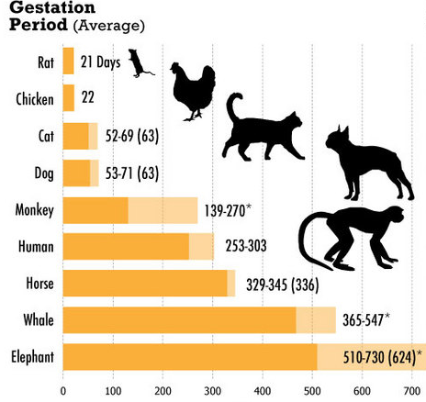

Slide 18
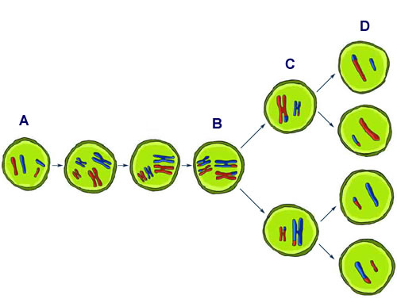
Meiosis: Creating Sex Cells

Slide 19
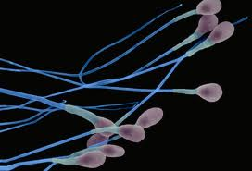
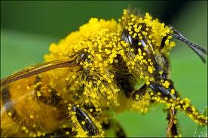
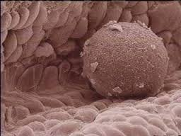
Meiosis
PROCESS: Sex Cell Division
PURPOSE: Create sex cells
(gametes)
CELL TYPES: Gametes
(sperm & egg)

Slide 20
Meiosis
# OF PARENT CELLS: 1
# OF DIVISIONS: 2
# OF DAUGHTER CELLS: 4
GENETIC MATERIAL AT END:
Each of the 4 daughter cells will be unique from the parent and unique from other daughter cells

Slide 21
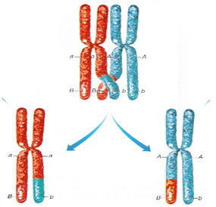
Genetic Variation: Crossing Over
ONLY occurs in meiosis
Does NOT occur in mitosis

Slide 22
VOCABULARY
HAPLOID = HALF the number of chromosomes (1n) or just (n)
Meiosis starts with 1 DIPLOID cell by ENDS with 4 HAPLOID cells
Cuts the number of chromosomes in half

Slide 23
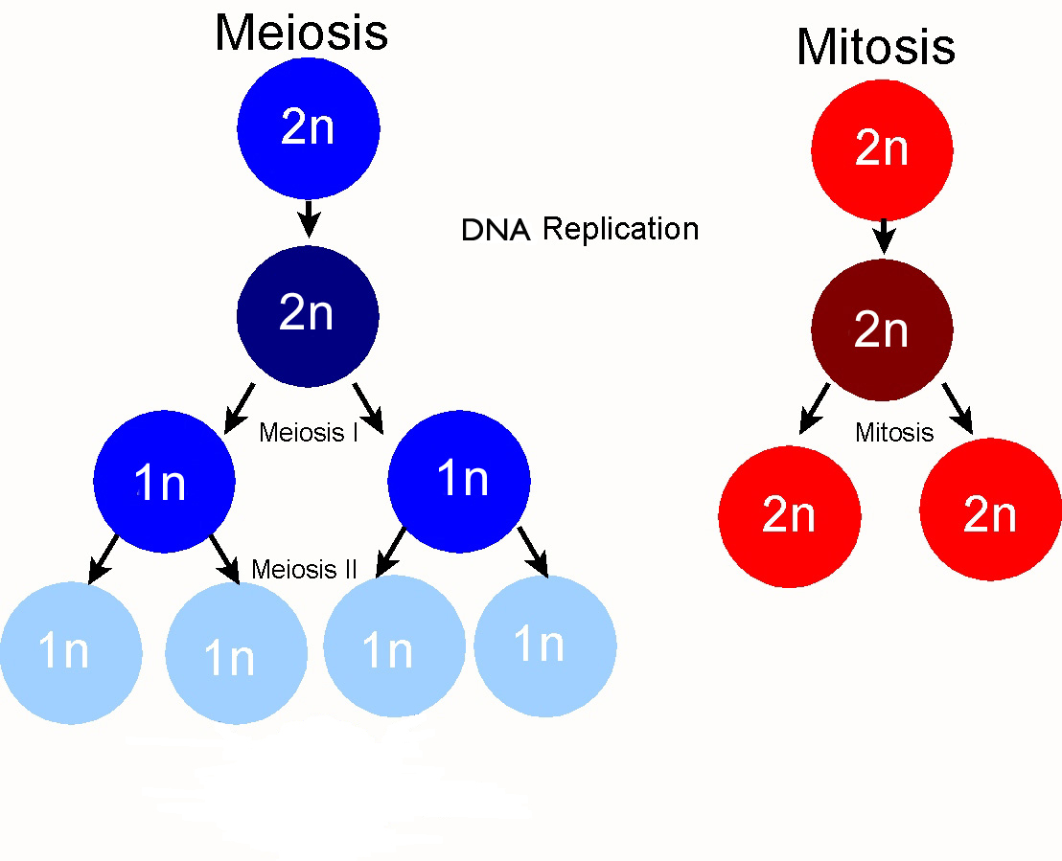

Slide 24
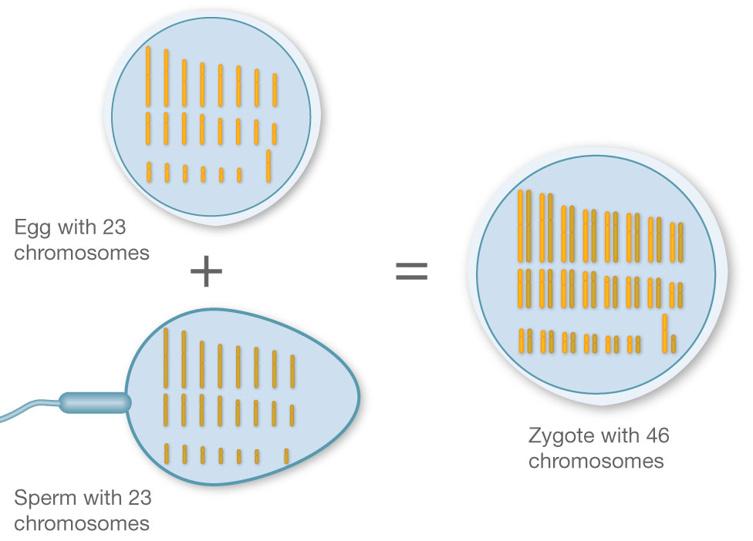

Slide 25
Differentiation How does ONE fertilized egg become all the different tissue types in our bodies?
Remember that genes in our DNA codes for proteins
Those genes can be turned ON or turned OFF
Cell interactions, hormones, environmental factors
Pancreas makes insulin
Lungs do not

Slide 26
Sources of Genetic Variation
ONE – Mutations (Replication)
As discussed in last unit, mutations can occur in cells
If mutations occur during replication in gametes, mutation will be passed to offspring leading to potentially new traits in offspring

Slide 27
Sources of Genetic Variation
TWO – Mutations (Environmental Factors)
Again - As discussed in last unit, mutations can occur in cells
If mutations caused by environmental factors occur in gametes, they can also be passed to the offspring

Slide 28
Sources of Genetic Variation
THREE - Meiosis
New genetic combinations from meiosis
Partially due to the separation of homologous pairs (each gamete is haploid)
Also due to crossing over – aids in every gamete being genetically unique

Slide 29
Nondisjunction
In addition, some genetic disorders are due to failure of meiosis to occur properly
Nondisjunction – failure of meiosis to properly separate chromosomes in gametes

Slide 30
Nondisjunction
Gametes end up with too few or too many chromosomes
Examples:
Down’s Syndrome (Trisomy 21)
Klinefelter’s Syndrome (XXY)
Turner’s Syndrome (X)
Notes:
TURNER
short stature (usually under 5' tall) is the most common feature of TS
narrow, high-arched palate
retrognathia (lower jaw not prominent)
ears protruding outward, and/or low set, and/ or rotated toward neck low hairline
webbed neck (excess or stretched skin) which may include a lowered hairline
droopy eyes
strabismus (lazy eye)
broad chest
cubitus valgus (arm turns slightly out at the elbow)
scoliosis (curvature of spine)
flat feet
small and narrow fingernails, toenails that turn up
short fourth metacarpal (bone in hand under knuckle)
edema (swelling or puffiness) or hands and feet, especially at birth
KLINEFELTER
Boys and teenagers
Taller than average stature
Longer legs, shorter torso and broader hips compared with other boys
Absent, delayed or incomplete puberty
After puberty, less muscular bodies and less facial and body hair compared with other teens
Small, firm testicles
Small penis
Enlarged breast tissue (gynecomastia)
Weak bones
Low energy levels
Shyness
Difficulty expressing feelings or socializing
Problems with reading, writing, spelling or math
Attention problems
Men
Infertility
Small testicles and penis
Taller than average stature
Weak bones
Decreased facial and body hair
Enlarged breast tissue
Decreased sex drive

