Slide 1
Being a Scientist Doesn’t Mean You Have to Wear A Lab Coat

Slide 2
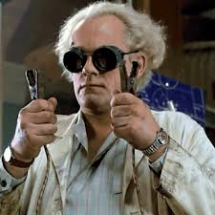
Scientist?
What leads you to believe that this man is a scientist?

Slide 3
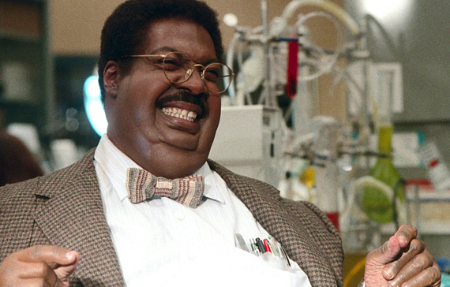
Scientist?
What about this man?
Eddie Murphy as
The Nutty Professor

Slide 4
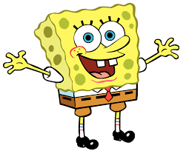
Scientist?
Sponge Bob?

Slide 5
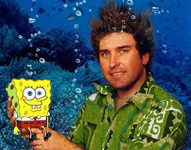
Scientist?
What about this man?
His name is Stephen Hillenberg
Marine Biologist
Sponge Bob’s Creator

Slide 6
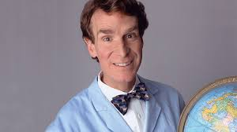
Scientist?
Bill Bye
The Science Guy: Television show that combines science and FUN!
Physics: Engineer for Boeing – designing fighter jets
“Leave the world better than you found it. Sometimes you gotta pick up someone else’s trash.”

Slide 7
There are millions of scientists out there!

Slide 8
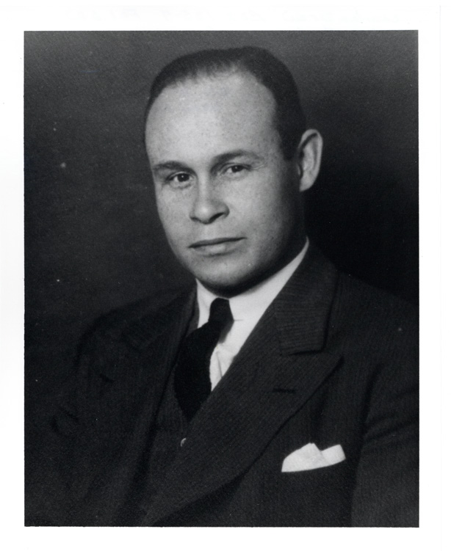
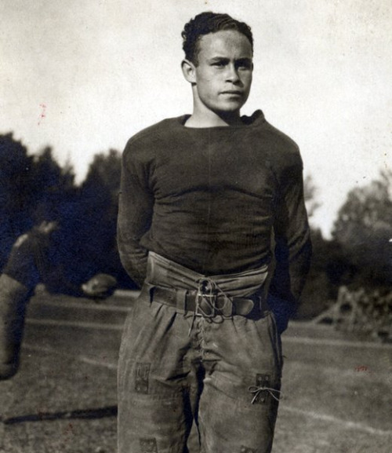
Charles Drew
Charles Drew was an awesome athlete but he decided to become a doctor. He was one of the first doctors to study blood and plasma. He discovered that blood and plasma could be stored safely and opened the first blood bank. He also created the “Red Cross Blood Bank.”

Slide 9
Mario Molina
Mario Molina researched chloroflurocarbons (CFC’s) and discovered that CFC’s damaged our atmosphere, specifically the ozone layer. His research banned CFC’s in most countries in efforts to help the environment. He won the Nobel Prize in chemistry in 1995.

Slide 10
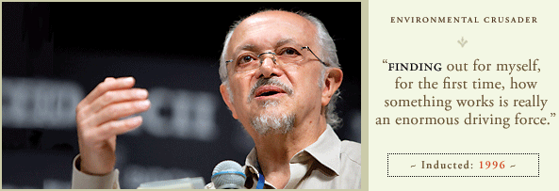

Slide 11
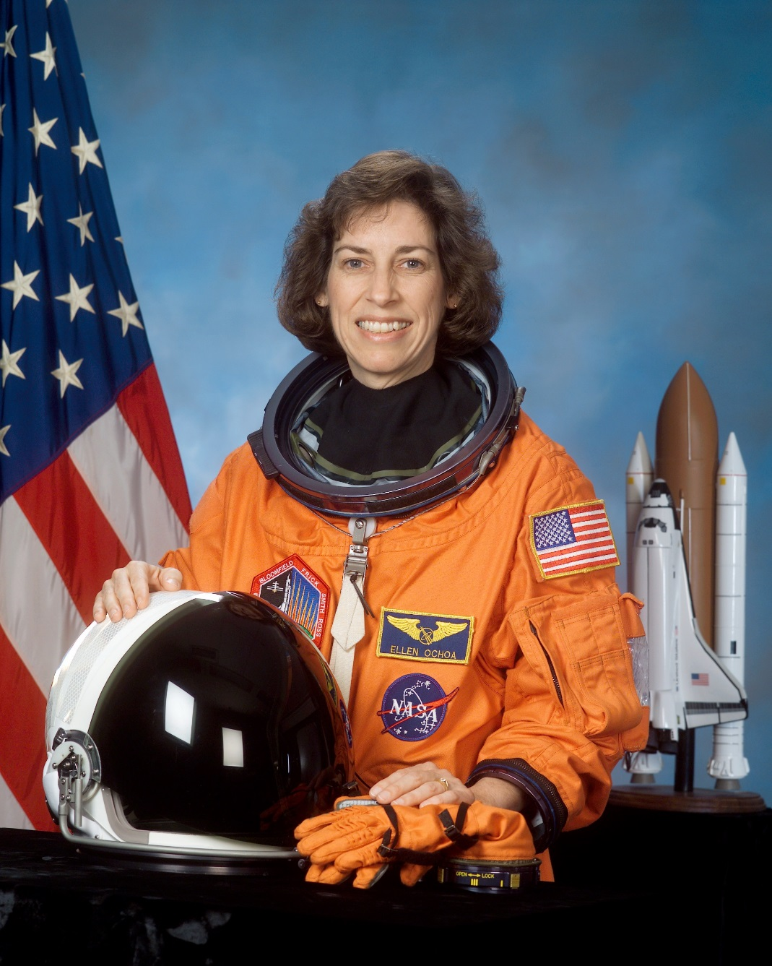
Ellen Ochoa
Ellen Ochoa was the first Hispanic woman in space. She started space missions in 1991. She has spent over 900 hours in space and received many awards of recognition for her work from NASA.

Slide 12
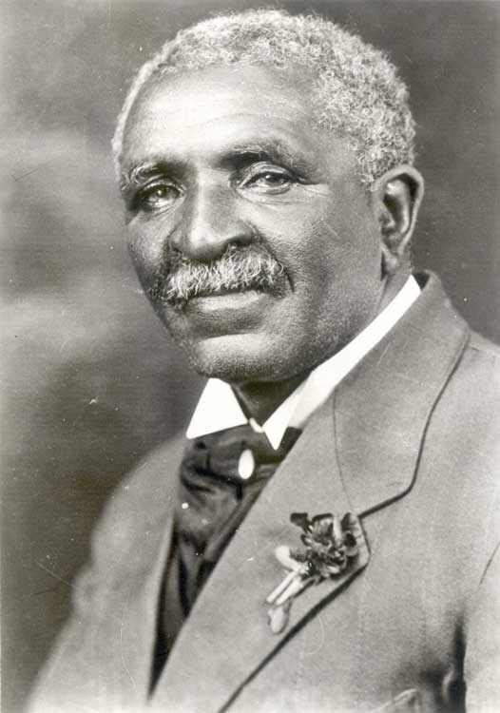
George Washington Carver
George Washington Carver was born into slavery. However, he later received two degrees in agriculture. He also revolutionized agriculture by introducing peanuts and soybeans to southern crops (restoring nitrogen and keeping soil healthy). He found over 300 uses for peanuts!

Slide 13
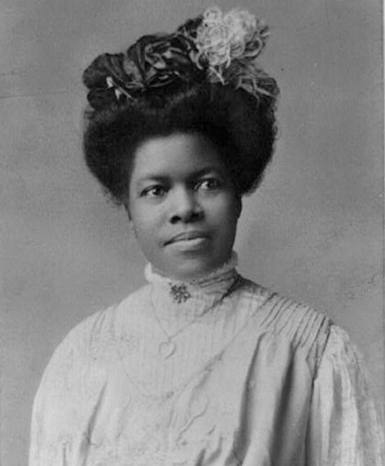
Rebecca Cole
Rebecca Cole was the 2nd black woman to graduate from medical school. She joined Elizabeth Blackwell in helping to teach hygiene and childcare to families in poor neighborhoods

Slide 14
Elizabeth Blackwell
Elizabeth Blackwell was the 1st woman to graduate from medical school in 1849. The students and staff at Geneva Medical College thought she was joking and so they accepted her thinking it was a joke. But they weren’t too happy when they found out she was serious. After graduation, she founded the London School of Medicine for Women

Slide 15
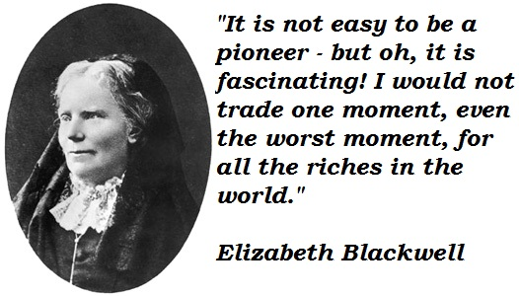

Slide 16
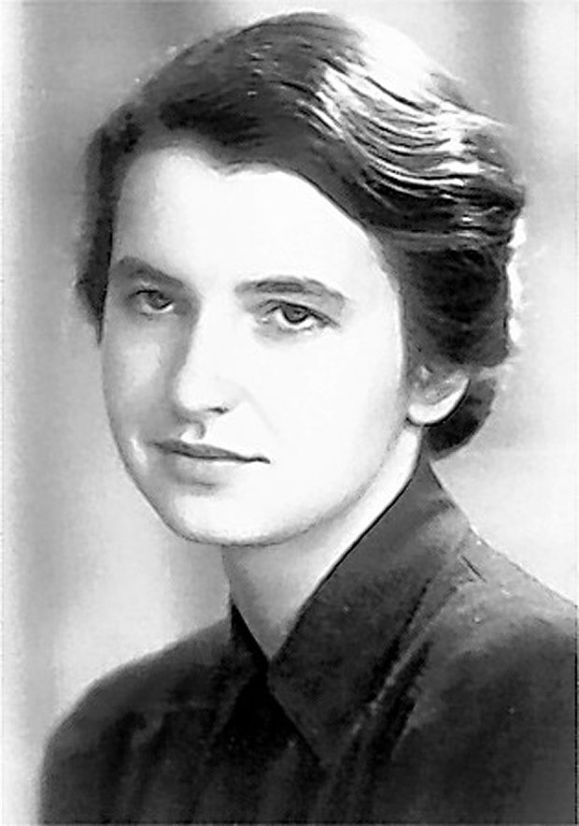
Rosalind Franklin
Rosalind Franklin became a physical chemist and while working at King’s College in England, she discovered the helix shape of DNA. Her work was later used by Watson and Crick, who were credited with the discovery of DNA. Rosalind Franklin did not receive credit for her work.

